Slide 1
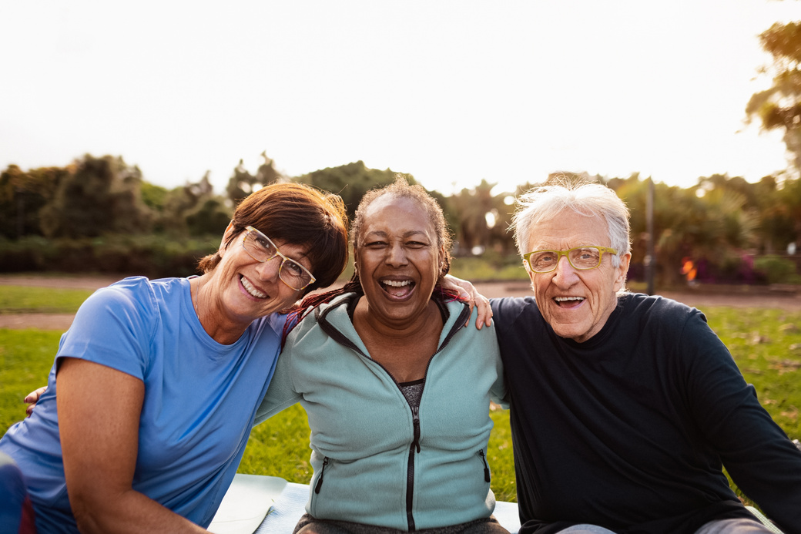


MONTEREY CALIFORNIA
Monterey Village helps older adults remain active, connected, and independent in the place they call home while enhancing the quality
of life in our community.
5 REASONS TO JOIN MONTEREY VILLAGE:
1. FUN TIMES TOGETHER: Good friends, good fun, good food - what's not to love?
2. AMAZING NEIGHBORS: Share stories and laugh together - everyone has something great to bring!
3. HELPING HANDS: Stay independent at home with support that gives you (and your family) peace of mind.
4. TRY NEW THINGS: Keep your mind sharp and body active by jumping into new adventures!
5. GET OUT THERE: Enjoy everything Monterey offers and help others do the same by volunteering.
WHO WE ARE:
We are a network of dedicated local residents who provide access to support services that help older adults engage in community activities and continue living independently in their homes.
Our village is a volunteer-powered membership organization that connects older adults to the community resources, engaging programming, and professional expertise they need to live fulfilling lives of purpose and promise.
JOIN US:
Become part of our village community as a member or volunteer. Contact Jennifer Golden at jennifer@montereyvillage.org or visit montereyvillage.org to learn more about how we can support you or how you can contribute to our village.

