Slide 1
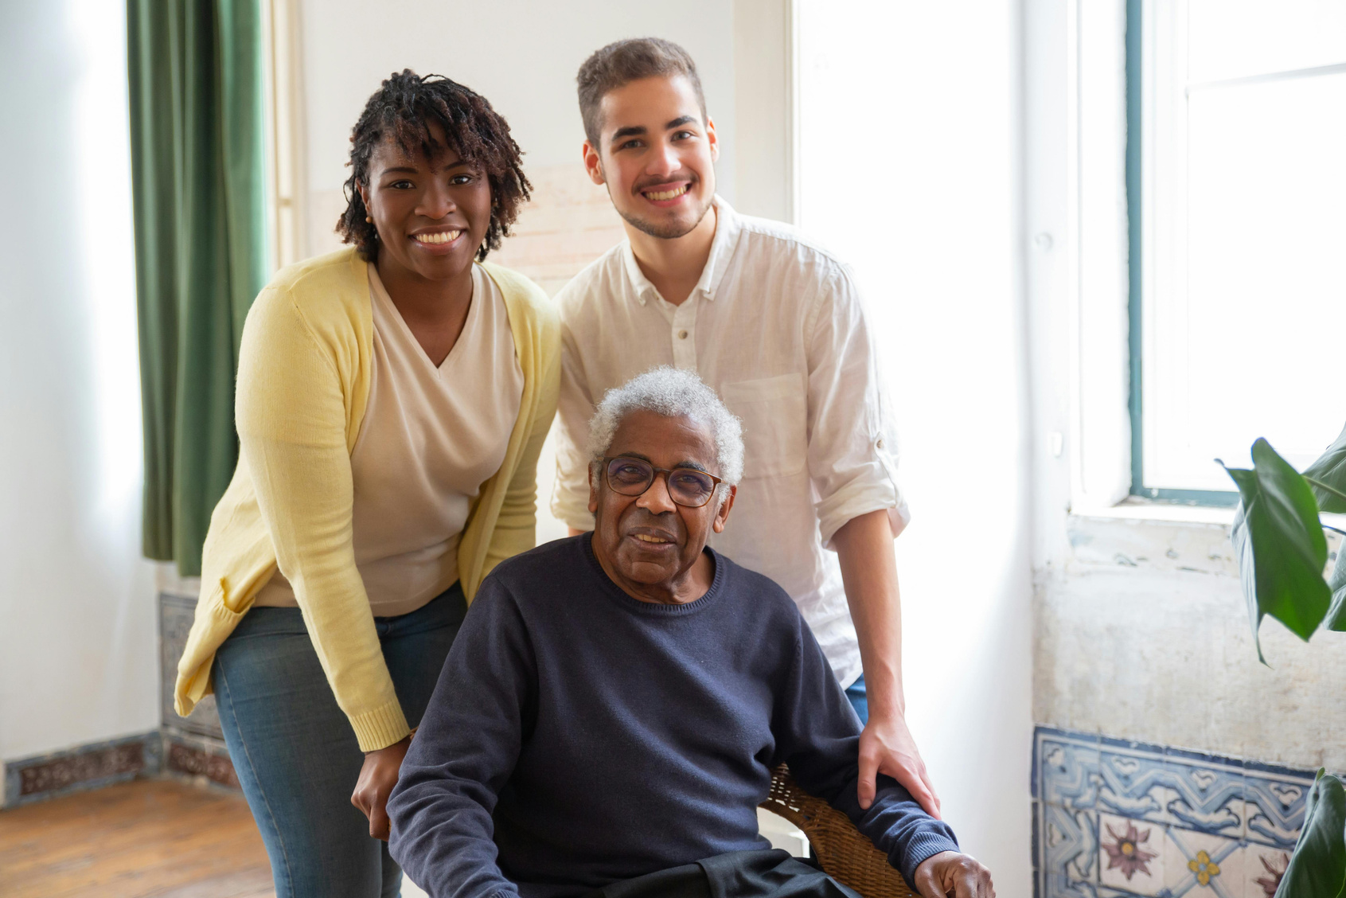




IT TAKES
VILLAGE
A
TO
AGE BETTER

Slide 2
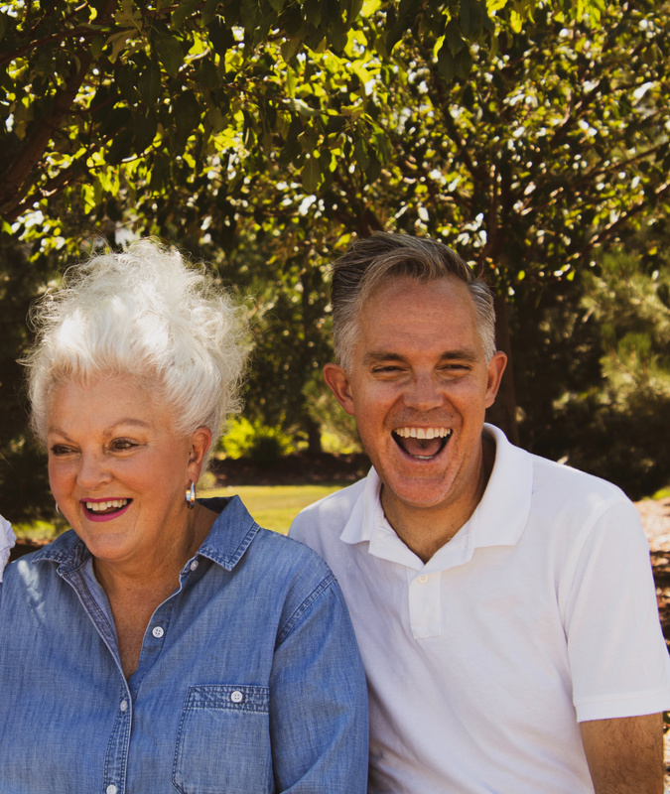

We're local folks who help older adults stay active, connected, and independent in their home - making our whole community better for everyone.
Need a ride? Tech driving you crazy? Lightbulb you can't reach? We've got you covered with volunteer help, plus fun get-togethers and learning opportunities.
Come join us. Become a member or volunteer!
Learn more about our social activities, programs, and supportive services at
VillageWebsite.org

